Slide 1

C++ Control Flow
Session#2

Slide 2
Session’s Agenda
If, Else
For Loop
While, Do While Loop
Break, Continue
Switch Statements
More Materials

Slide 3
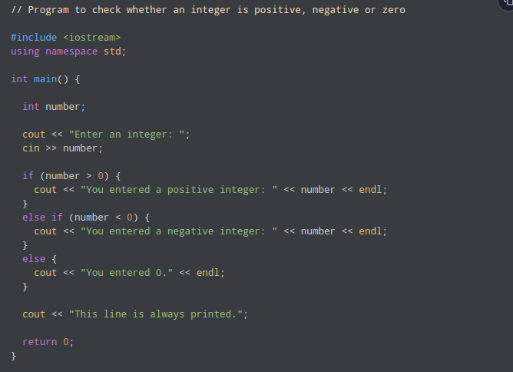
If,
Else

Slide 4
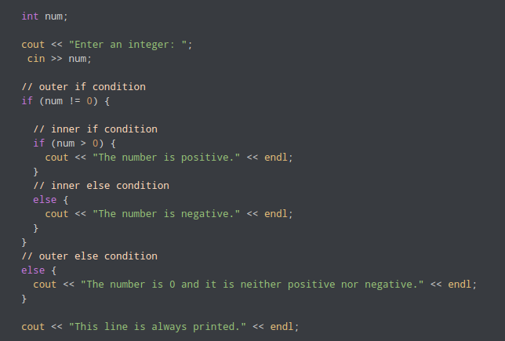
Nested If
Statement

Slide 5
For Loop
Example 1: Printing Numbers From 1 to N
Example 2: Display a text N times
Example 3: Find the sum of first N Numbers
Infinite for loop

Slide 6
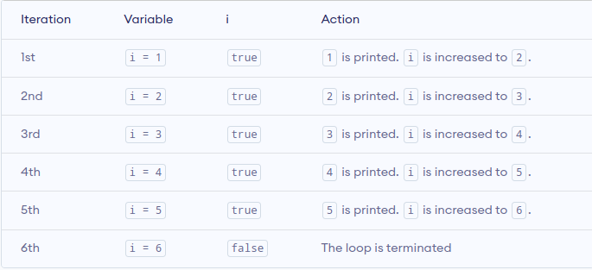
Example 1: Printing Numbers From 1 to N

Slide 7
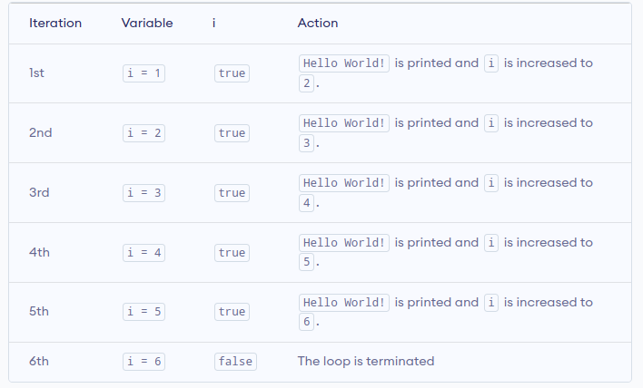
Example 2: Display a text N times

Slide 8
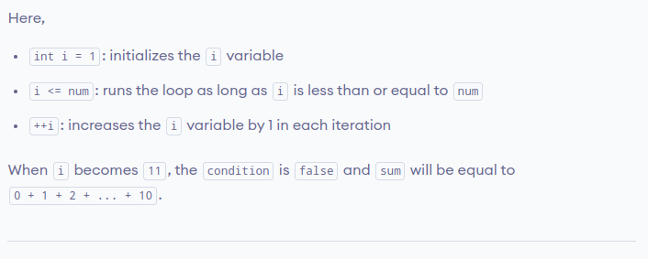
Example 3: Find the sum of first N Numbers

Slide 9
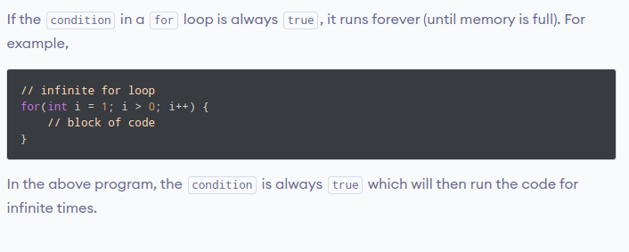
Infinite for loop

Slide 10
While, Do …. While
While loop
Do …. While Loop
While VS Do …. While

Slide 11
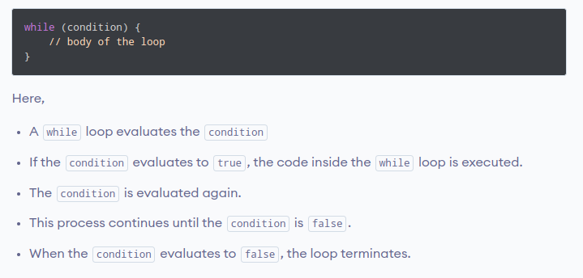
While Loop

Slide 12
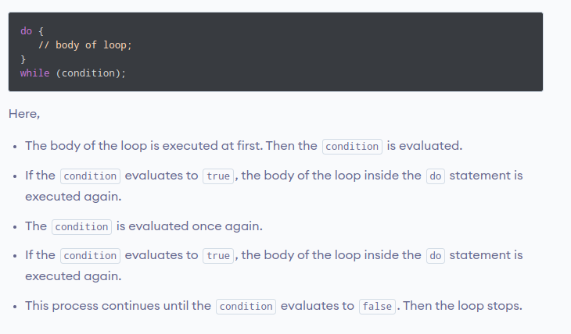
Do ….. While Loop

Slide 13
While VS Do …. While
The main difference between a while and do while is that in do while, the loop will execute once even before checking the condition, whereas in a while loop, the loop executes if the condition is true

Slide 14
Break, Continue
In C++, the break statement terminates the loop when it is encountered.
In C++, the continue statement is used to skip the current iteration of the loop and the control of the program goes to the next iteration.

Slide 15
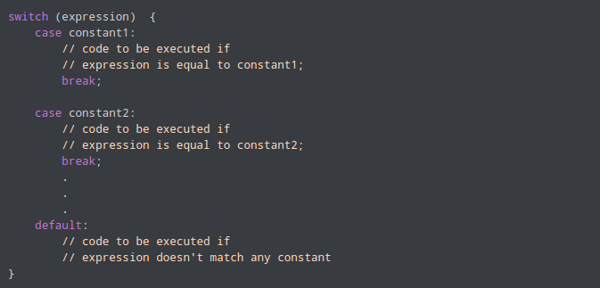
Switch Statements

Slide 16
More Materials
If, Else
For Loop
While, Do ... While
Break
Continue
Switch

